Slide 1


Quick Corpus Links for Writing Feedback
Benet Vincent
Hilary Nesi
Daniel Quinn

Slide 2
The Challenge
Not much time for feedback
Many writing problems hard to explain or not covered by grammars
Students may not understand feedback provided
The same types of problem often recur.
There must be a quicker, more effective way!
e.g.
‘Wrong word’
‘Incomplete sentence’
‘Meaning unclear’

Slide 3

Writing for a Purpose https://learnenglish.britishcouncil.org/en/writing-purpose/writing-purpose
Advice on university genres (essays, case studies, law problem questions etc.)
Examples from the BAWE corpus www.coventry.ac.uk/bawe
Linked to SketchEngine, an interactive corpus tool https://the.sketchengine.co.uk/open/

Slide 4
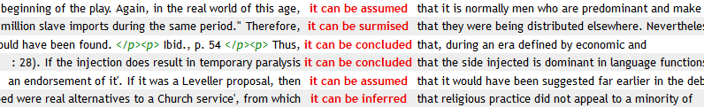
For example….
Conclusions of essays in the Humanities often contain this pattern:
it can/could be assumed/inferred/concluded that
You can click on the red words to get more context.
You can also click on a sidebar to find out the discipline of the writer, their level of study, age, and other details…
Writing for a Purpose provides a SketchEngine link to lines from the corpus:

Slide 5
Extension of WfaP approach to give quick feedback
Say you come across an error of this sort:
Ellis (2002) supports that formal grammar teaching has a delayed effect on language teaching.
Possibly not a frequent error in itself
But example of common type of error
Also not obvious how a student could check whether they were right

Slide 6
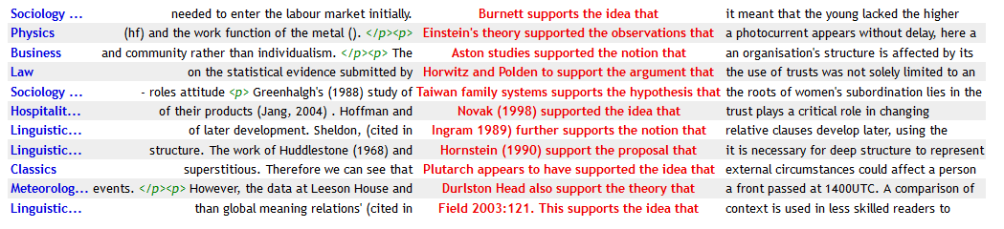
Extension of WfaP approach to give quick feedback
The student who writes…
Ellis (2002) supports that formal grammar teaching has a delayed effect on language teaching.
…can be directed to ske.li/ezt to see the error of their ways
other lecturers who spot a similar error could use the link in a similar way, if they have access to it…
These examples show the need for a noun (e.g. ‘idea’) between ‘support’ and ‘that’.

Slide 7
Link creation
Uses Corpus Query Language (CQL)
e.g. for the ‘supports that’ link:
[tag = "NP.?"] []{0,3} [lemma = "support"] [word = "the"] [tag = "NN.?"] [word ="that"]
But, crucially, potential users do not need to know this – they just need the website…
Takes time to make links – but they’re reusable…

Slide 8

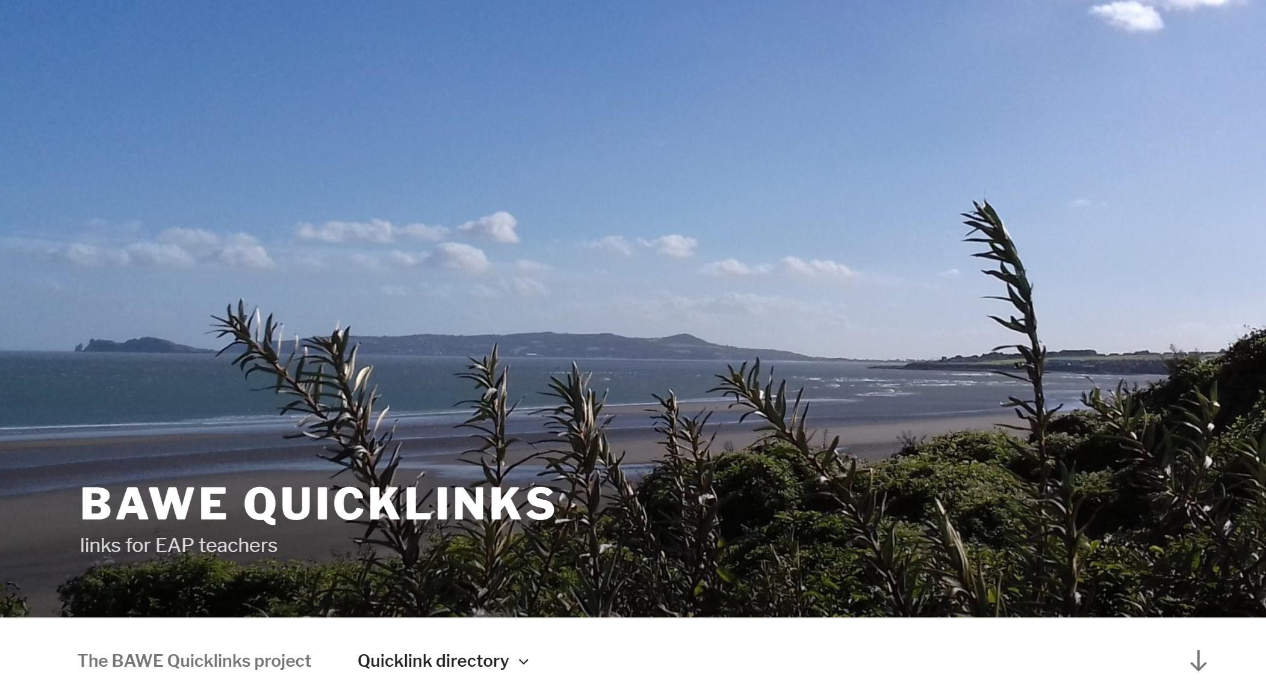
Database of links
Site here
thanks to Daniel Villar-Onrubia and the rest of the DoOO team who made this possible
thanks also to FAH Education Project funding

Slide 9
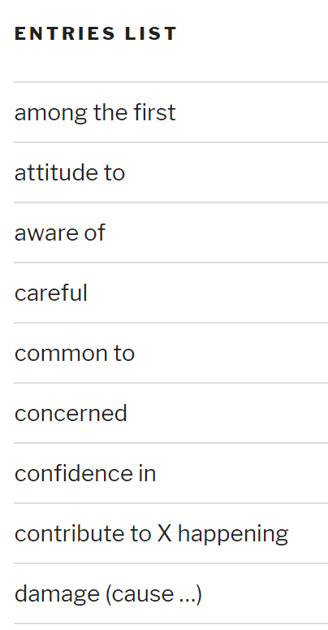
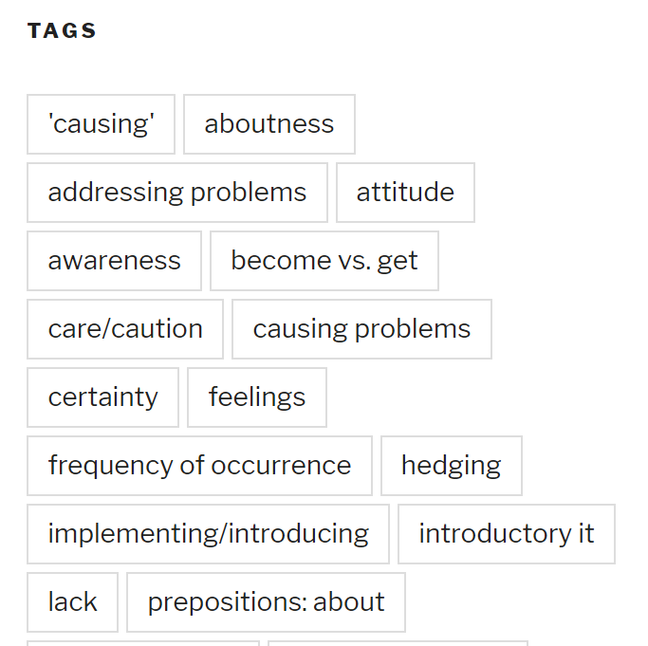
Navigating the site
Categorisation / tag-creation process still underway – may change

Slide 10
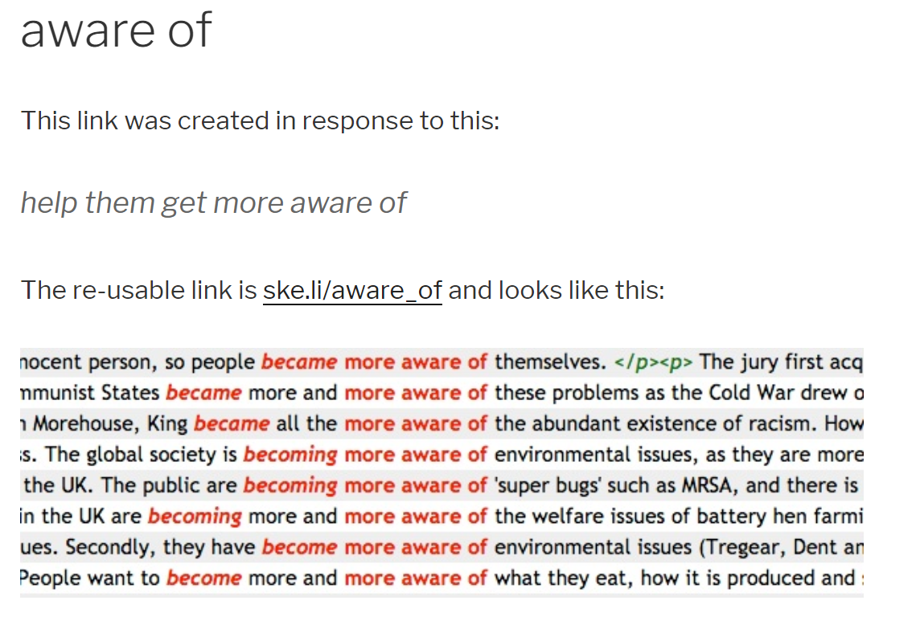
Structure of Entries
Entries look like this (at present)

Slide 11
How to use the links?
Simply provide a link to examples of acceptable usage
Provide two links for comparison (solution of or to?)
Provide link(s) with advice – e.g. “you need a noun (e.g. idea) between support and that”.
Provide link(s) with a prompt to encourage reflection / decision making (“what kind of word follows support? What tense is usually used?”)

Slide 12
Some considerations
Tutors need to be able to find the right link quickly
How should we group links to help this happen?
Specific examples (e.g. here) are best for correcting one particular mistake
More generic examples (e.g. here) address wider range of issues and more likely to be reused

Slide 13
Thanks for listening
Keep checking the site for updates:
http://BAWEquicklinks.coventry.domains
and please leave comments!

